Slide 1




SIMPLIFYING PHARMA LINK WITH ODOO

Slide 2
Our Team
HAGAR SHAWKY
MOHAMED HAMDY
DAVID EMAD
HEBA FAISAL
MOHAMED HASSAN
BOULA WAEL
Supervisor: ENG.MUSTAFA MANSY

Slide 3
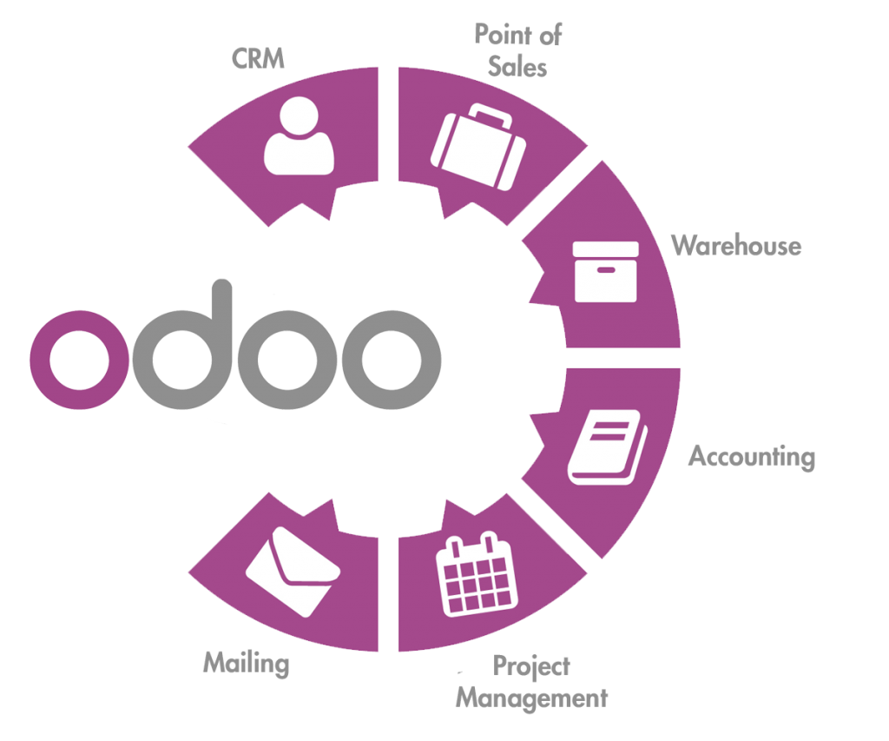
Content
Introduction
Business Model
Analysis
Implementation

Slide 4

Introduction
Pharma Link faced supply chain challenges—inefficient inventory management, order delays, and supplier coordination issues—that disrupted operations and product availability.
This project aims to solve these problems by implementing Odoo ERP, streamlining procurement, automating inventory, and enhancing supplier connections. With Odoo, Pharma Link will improve efficiency, ensuring better service for pharmacies and customers alike.

Slide 5
Objectives & Goals
Objectives
Streamline Supply Chain: Optimize procurement, inventory, and supplier coordination with Odoo ERP.
Automate Operations: Reduce manual tasks and minimize delays in order processing.
Increase Visibility: Provide real-time data for better decision-making.
Goals
Improve Efficiency: Ensure faster access to essential products.
Enhance Supplier Relations: Strengthen and simplify supplier partnerships.
Boost Customer Experience: Deliver timely, reliable service for both pharmacies and consumers.

Slide 6
Company Overview
Pharma Link revolutionizes the pharmaceutical supply chain by connecting pharmacies directly with suppliers through a seamless B2B and B2C marketplace.
Our platform empowers businesses to:
Efficiently manage inventory
Optimize procurement processes
Enhance customer delivery
With a comprehensive view of the supply chain, Pharma Link ensures that essential medications are always available, transforming the way healthcare is delivered.

Slide 7
Challenges
1. Inventory Inefficiencies - Frequent Stockouts, Overstocking, And Losses from Expired Products.
2. Slow Order Processing - Manual Handling Caused Delays and Fulfillment Errors.
3. Supplier Management Complexity - Limited Tracking Of Supplier Performance And Lead Times.
4. Lack of Customer Insights - No Centralized Data For Understanding Customer Needs And Trends.
5. Financial Discrepancies - Manual Entries Led To Billing Errors And Reporting Delays.
6. Compliance Challenges - Difficulty Maintaining Industry Standards And Accurate Documentation.

Slide 8
Why Choose Odoo ERP?
Comprehensive Functionality
Customization
User-Friendly Interface
Scalability
Open Source
Strong Community Support
Cost-Effective

Slide 9
Purchase Module
vendors
purchase order
call for tenders
purchase reports

Slide 10
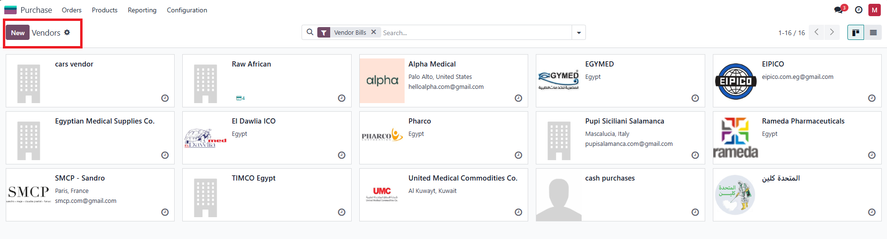
vendors

Slide 11
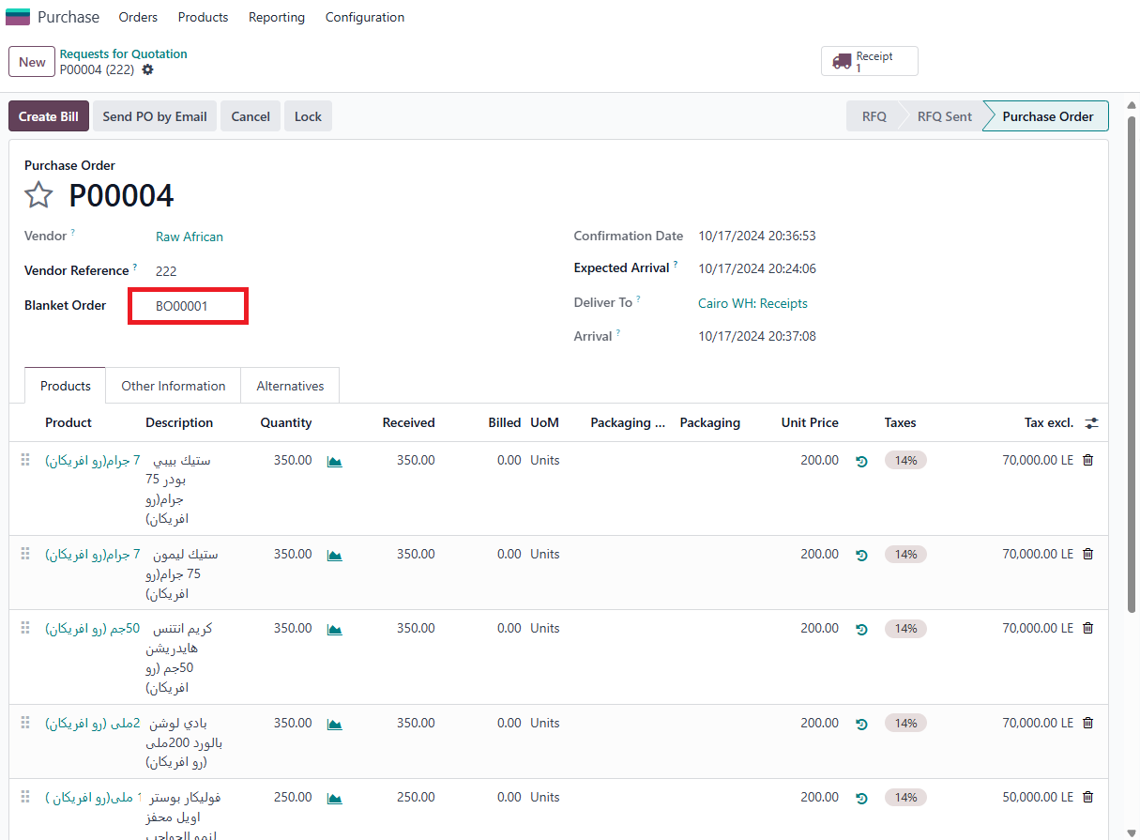
Purchase Order (Blanket Order)

Slide 12
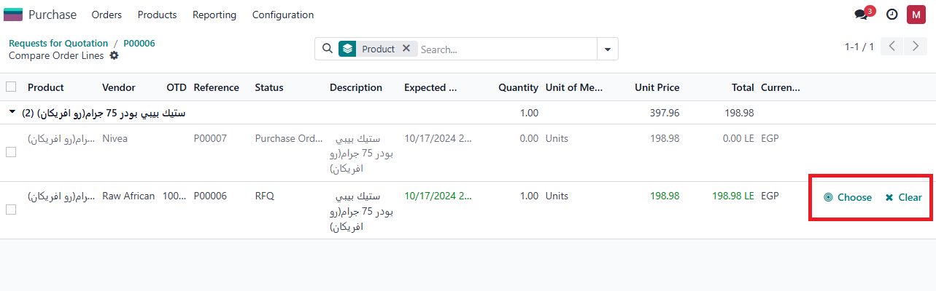
call for tenders

Slide 13
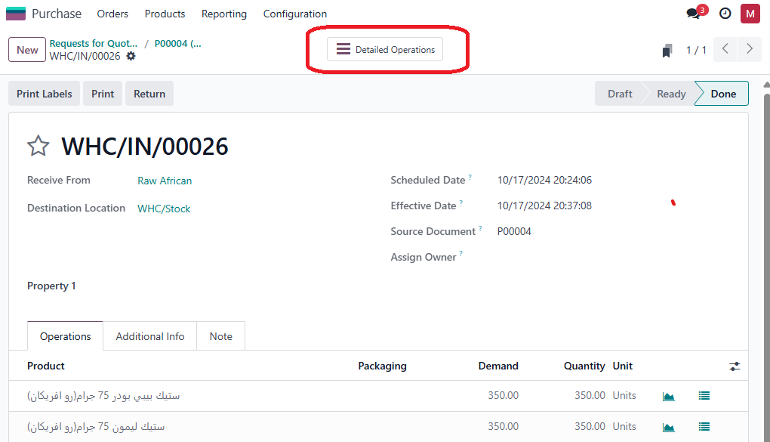
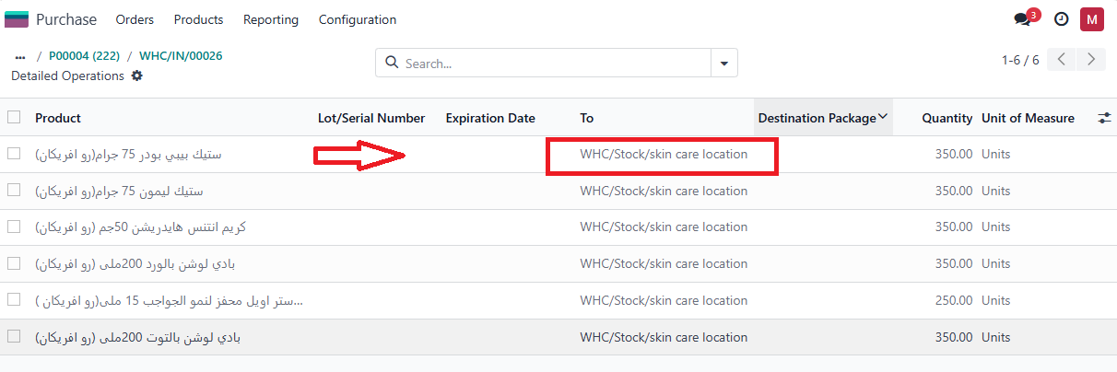

Slide 14
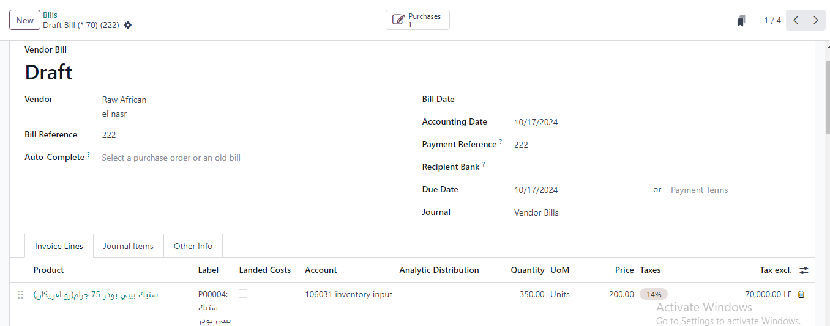
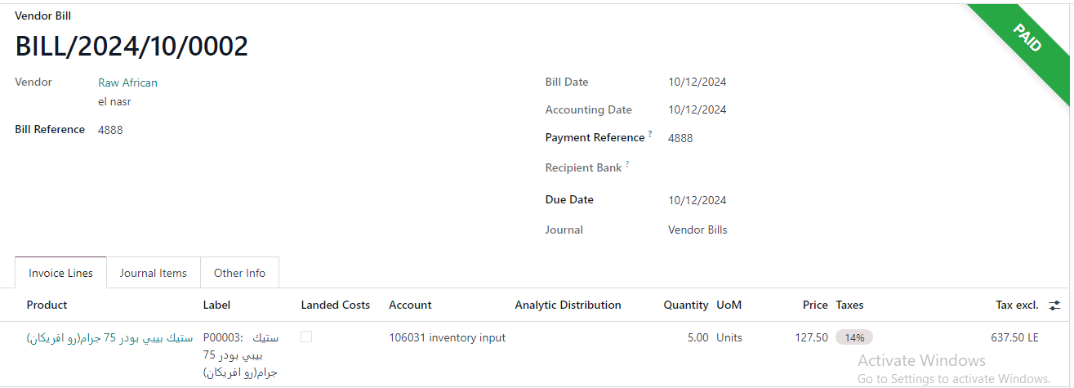
vendor bill

Slide 15
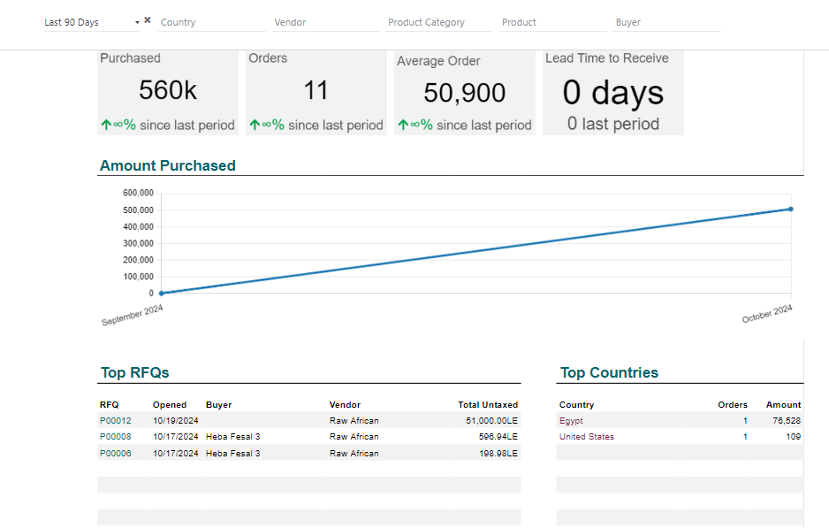
Purchase Report

Slide 16
Inventory Module
products
inventory warehouses
removal strategy
inventory location
virtual location
product category
putaway rules
recording rules
scrap
inventory check
inventory report
inventory flow

Slide 17
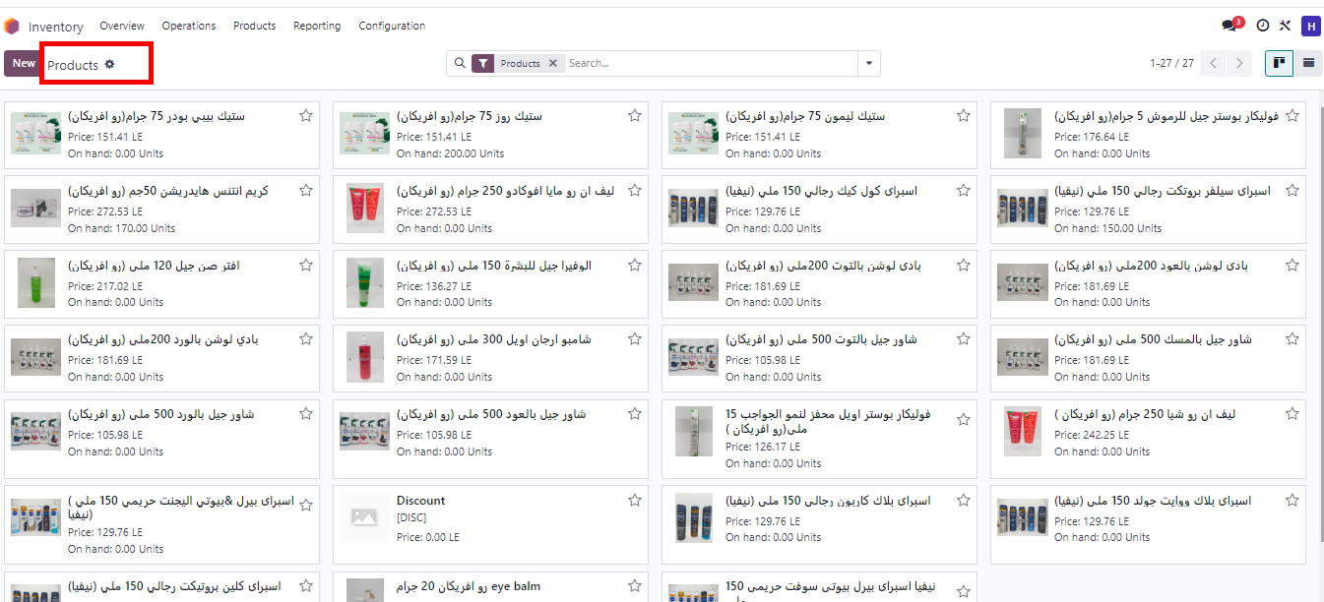
Products

Slide 18
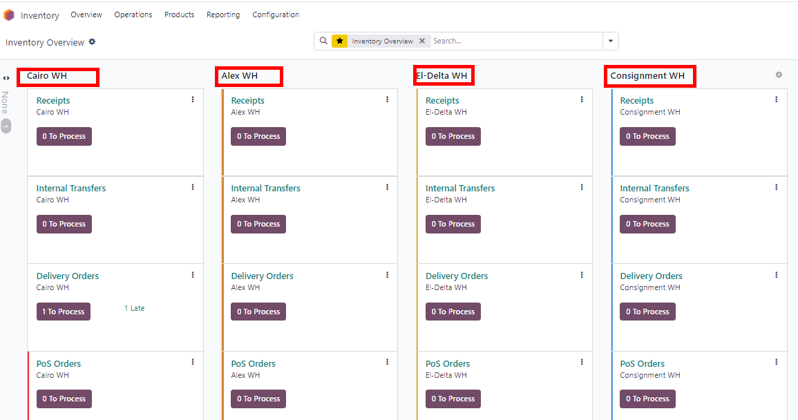
Inventory Warehouses

Slide 19
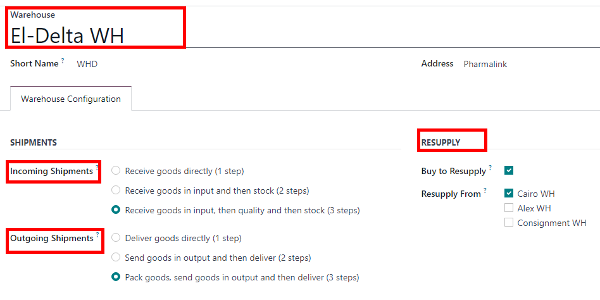
DELTA Warehouses
Resupply from Cairo WH
Incoming Shipments and Outgoing Shipments In 3 Steps To Check Quality

Slide 20
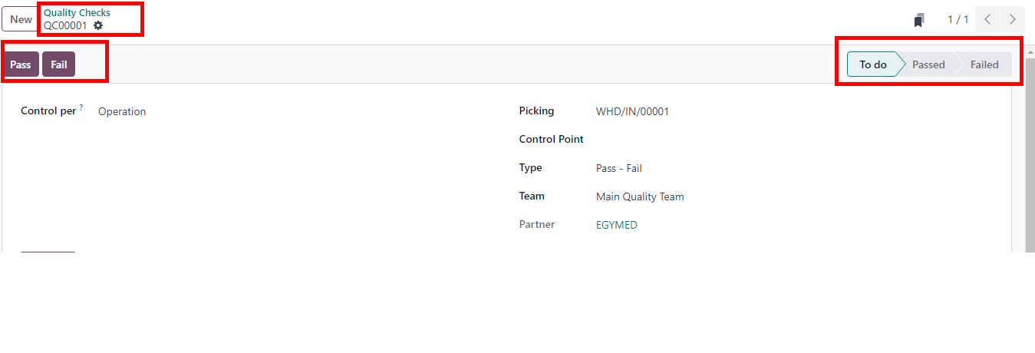
Quality check

Slide 21
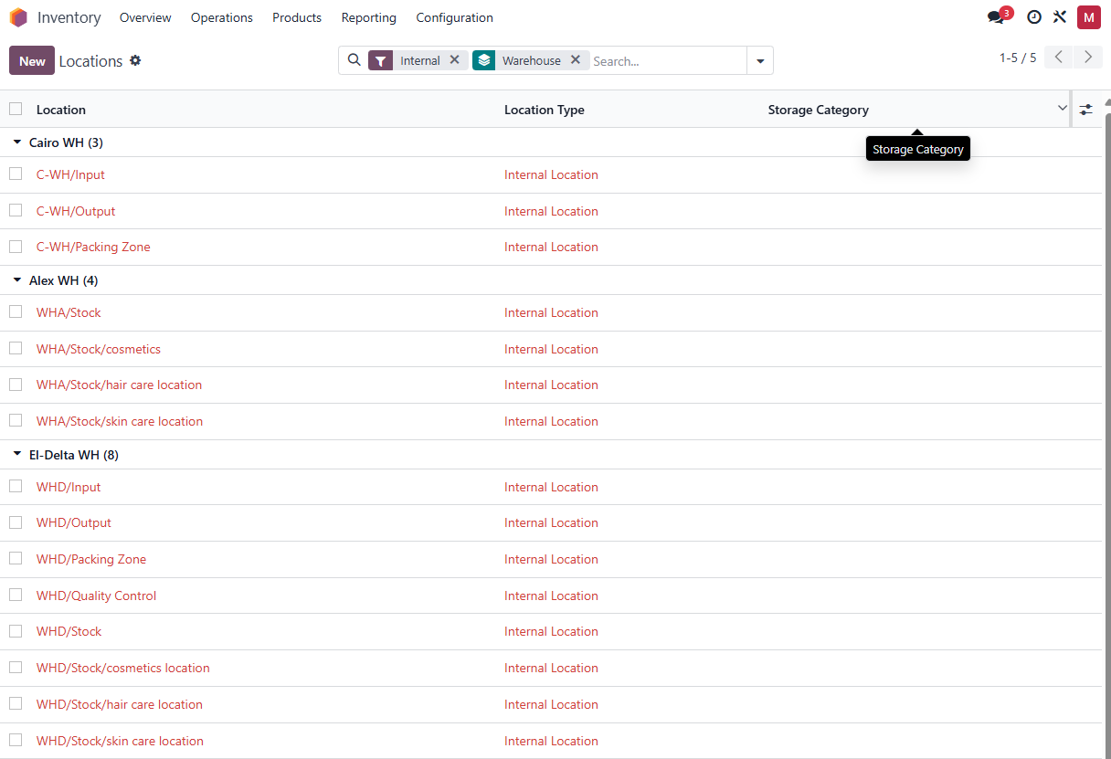
Inventory Locations

Slide 22
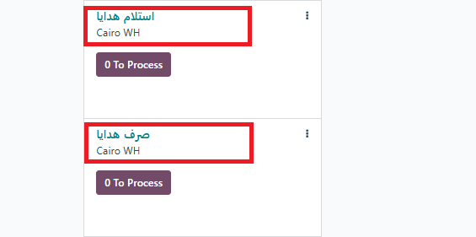
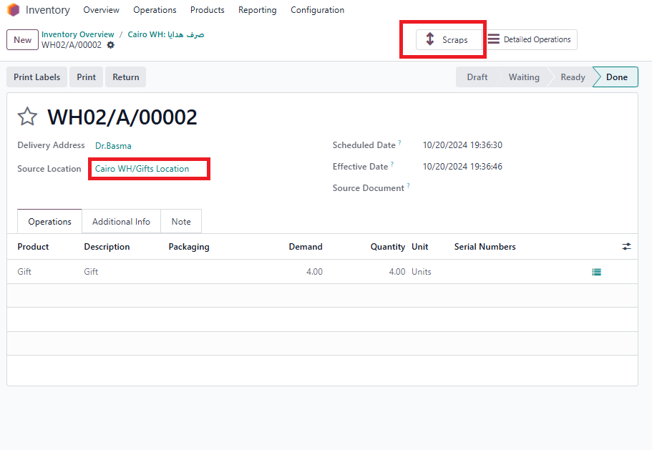
Virtual Location

Slide 23
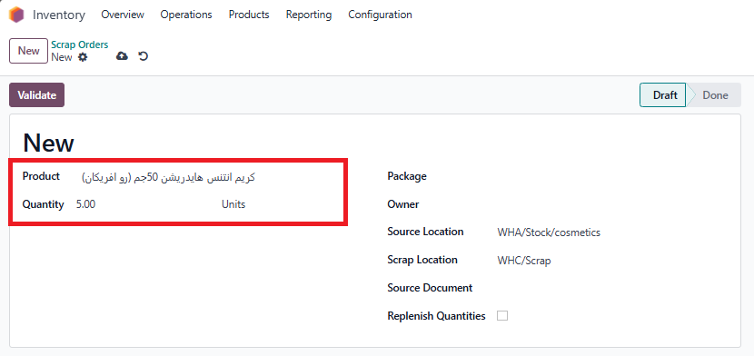
Scrap

Slide 24
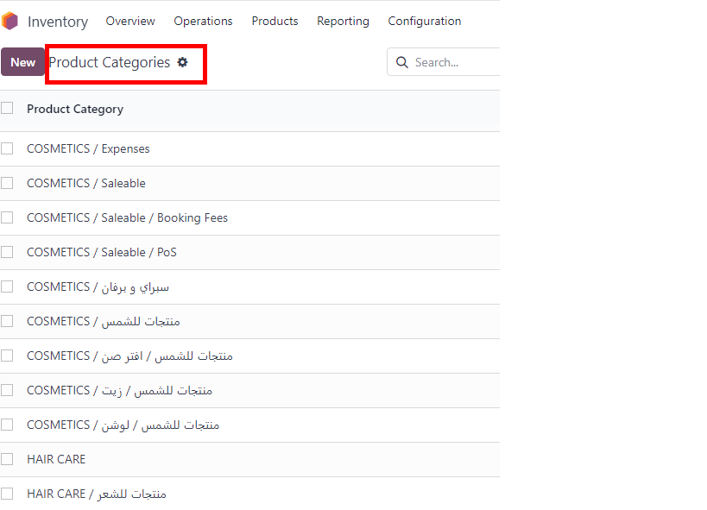
Product Category

Slide 25
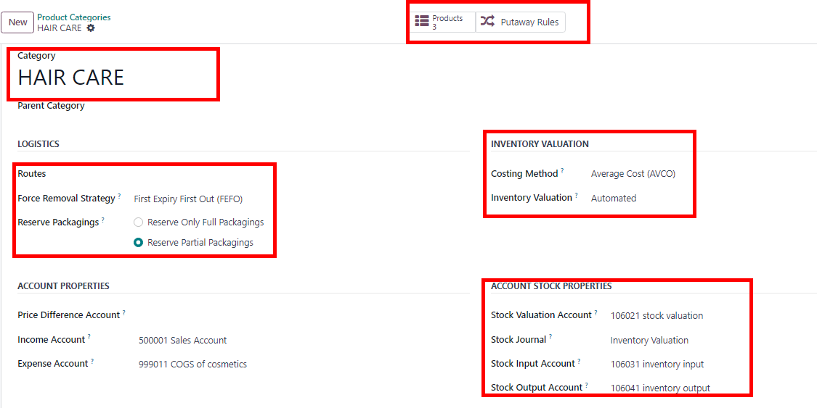
Example of product category

Slide 26
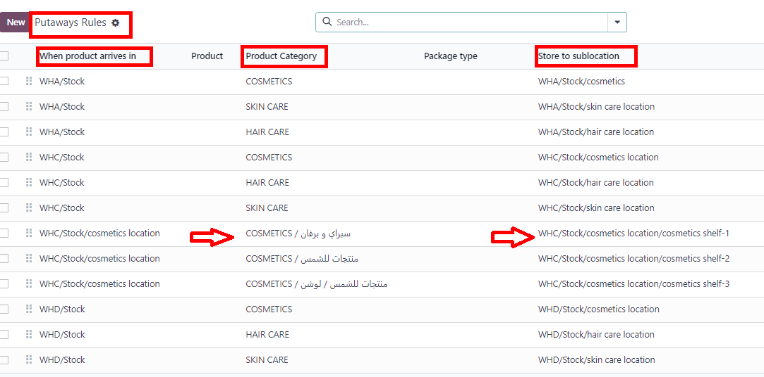
Putaways Rule

Slide 27
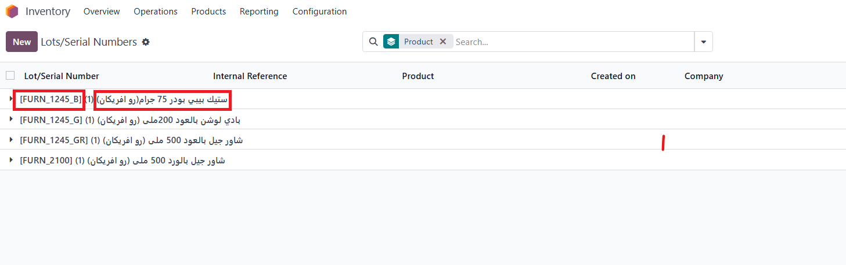
Lots Numbers

Slide 28
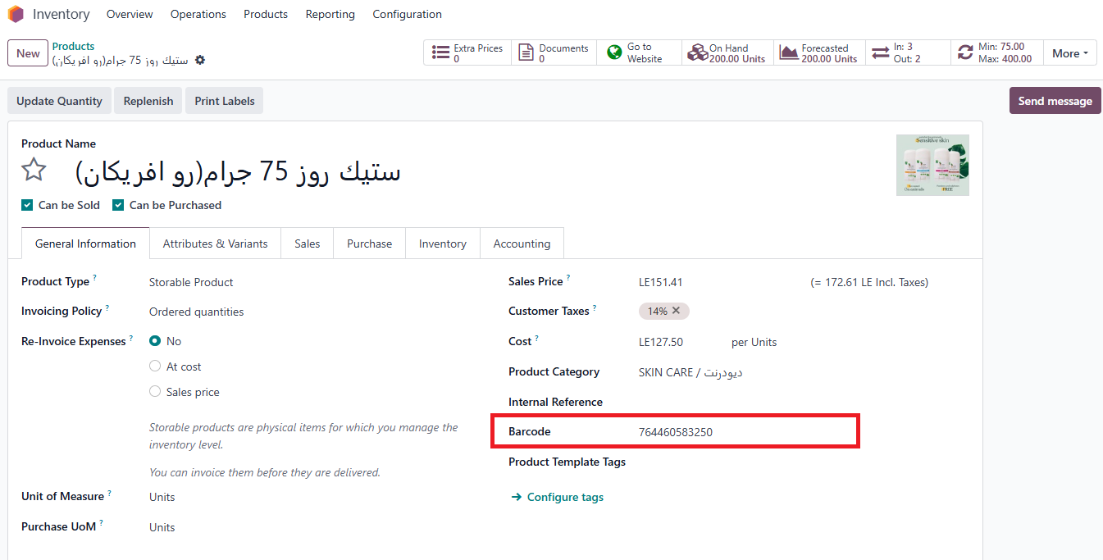
Products with Barcode

Slide 29
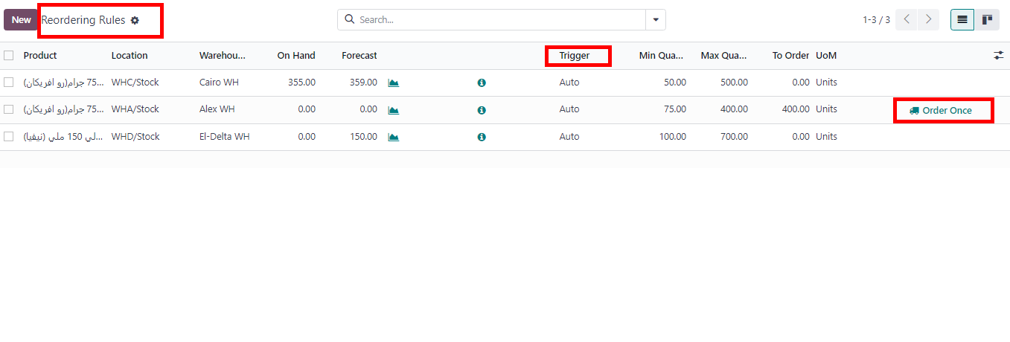
Reordering Rules

Slide 30
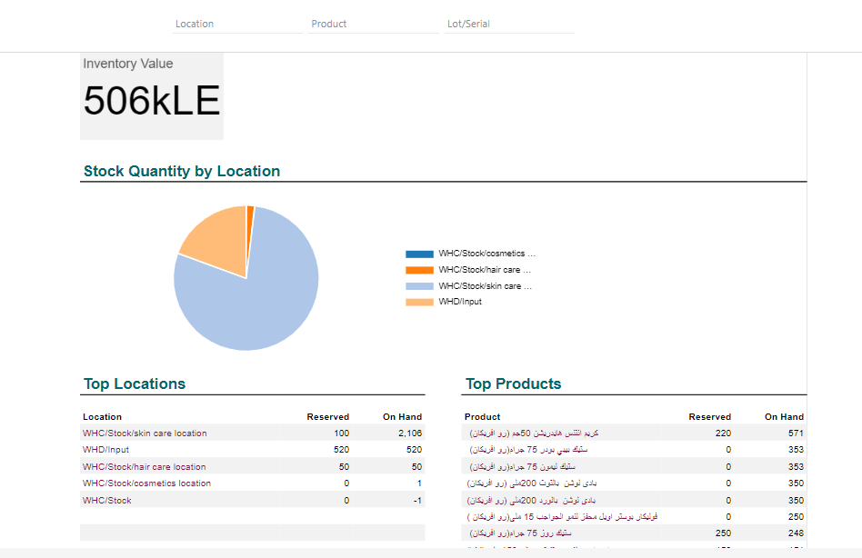
Inventory Report

Slide 31
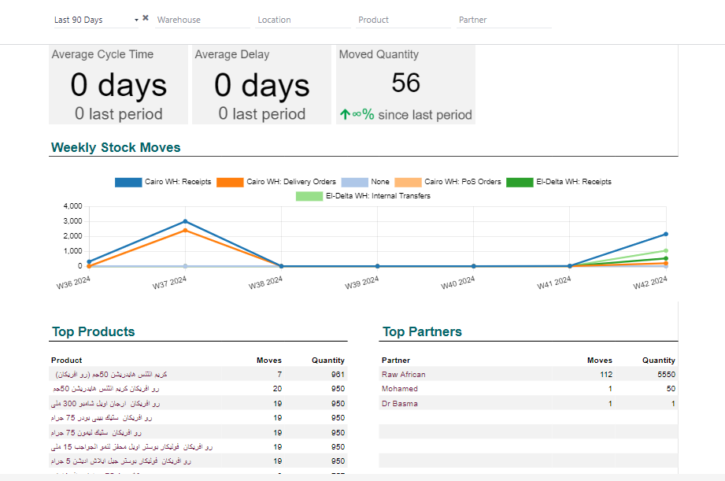
Inventory Flow

Slide 32
Sales Module
CUSTOMER
Pricelist
Shipping Method
Sales Order
Sales Report
point Of Sales

Slide 33
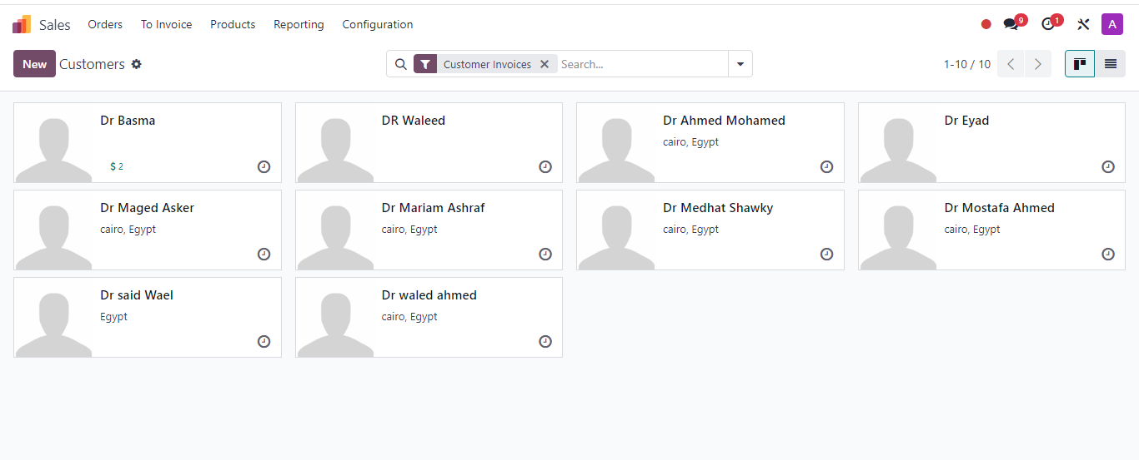
Customers

Slide 34
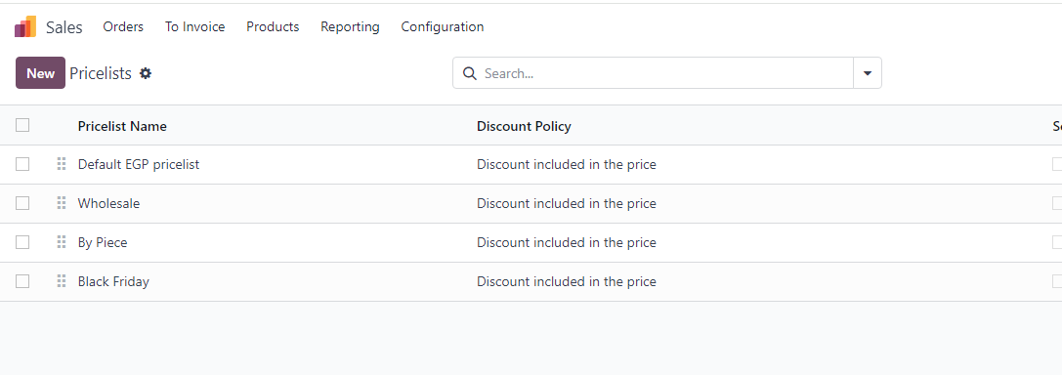
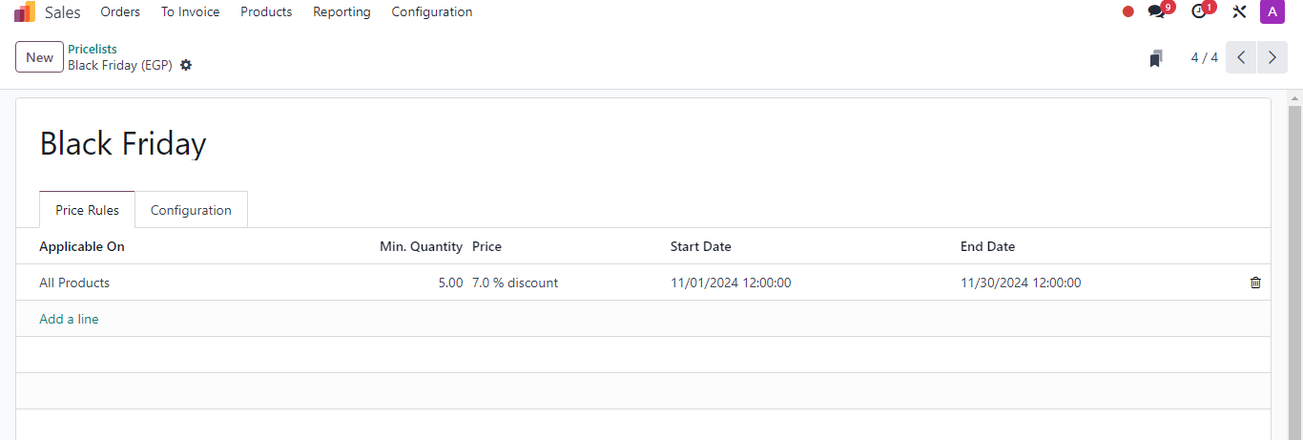
Pricelists
Example

Slide 35
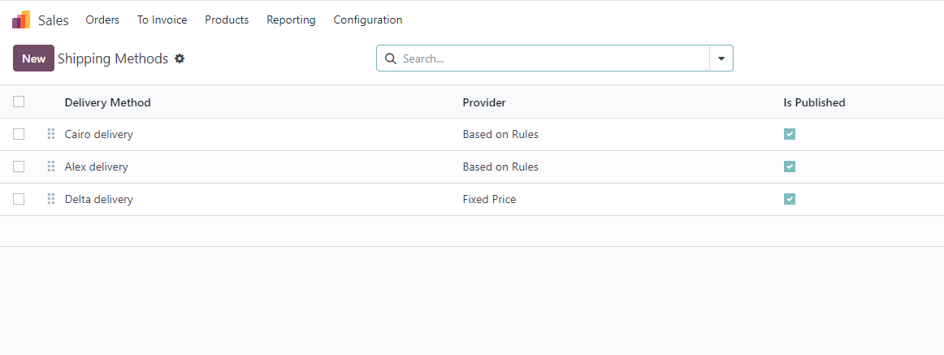
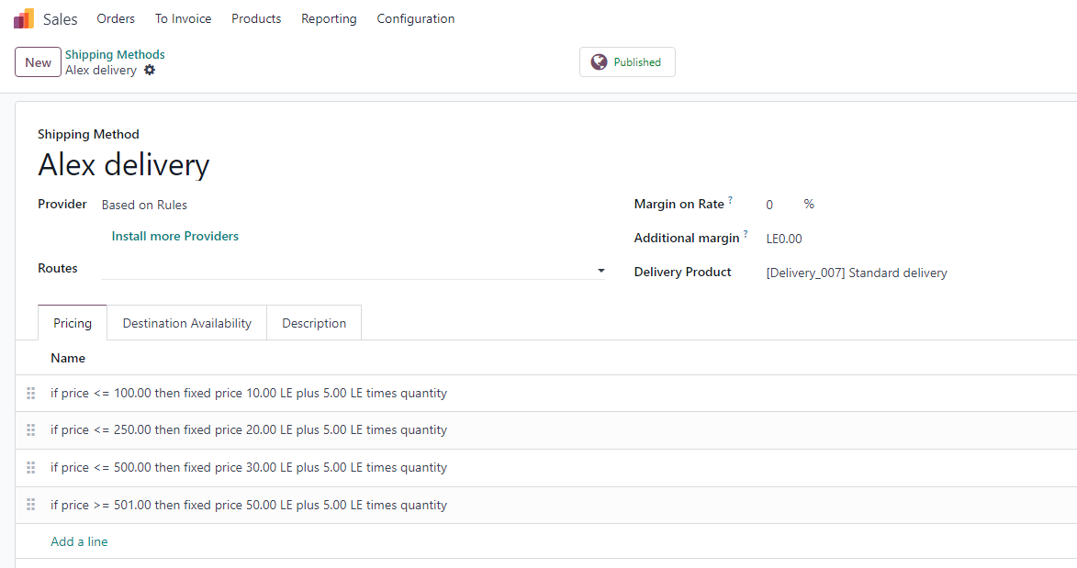
Shipping Methods
Example

Slide 36
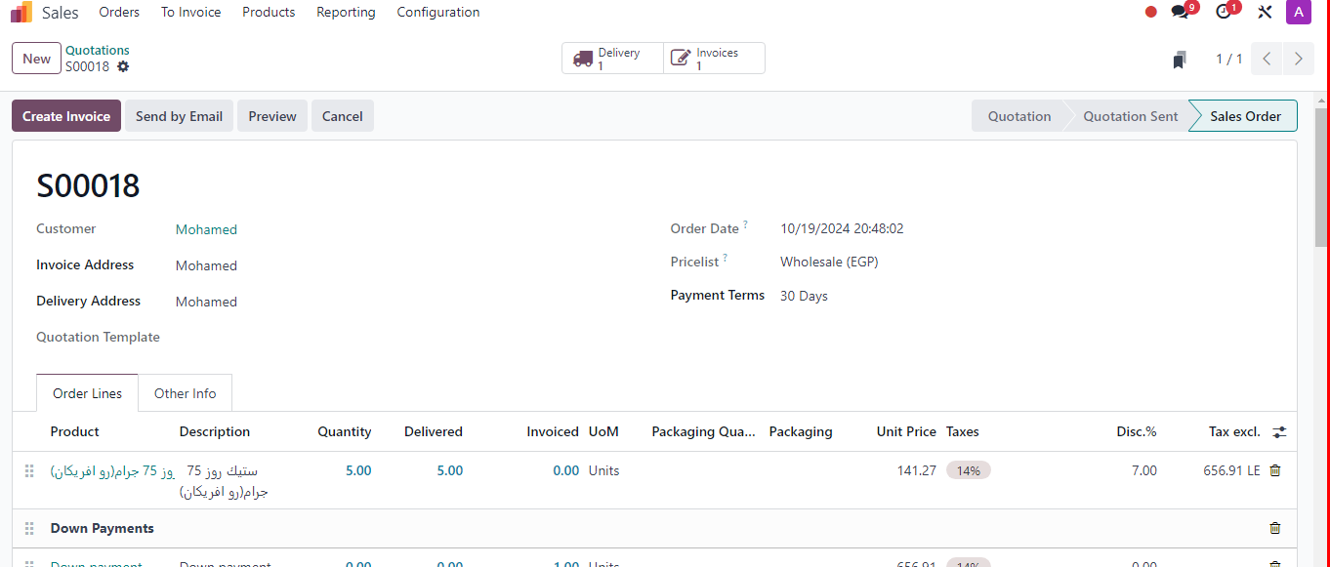
Sales Order

Slide 37
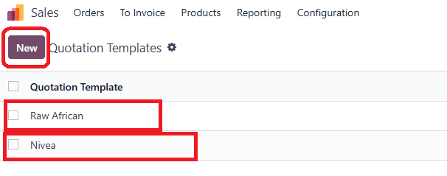
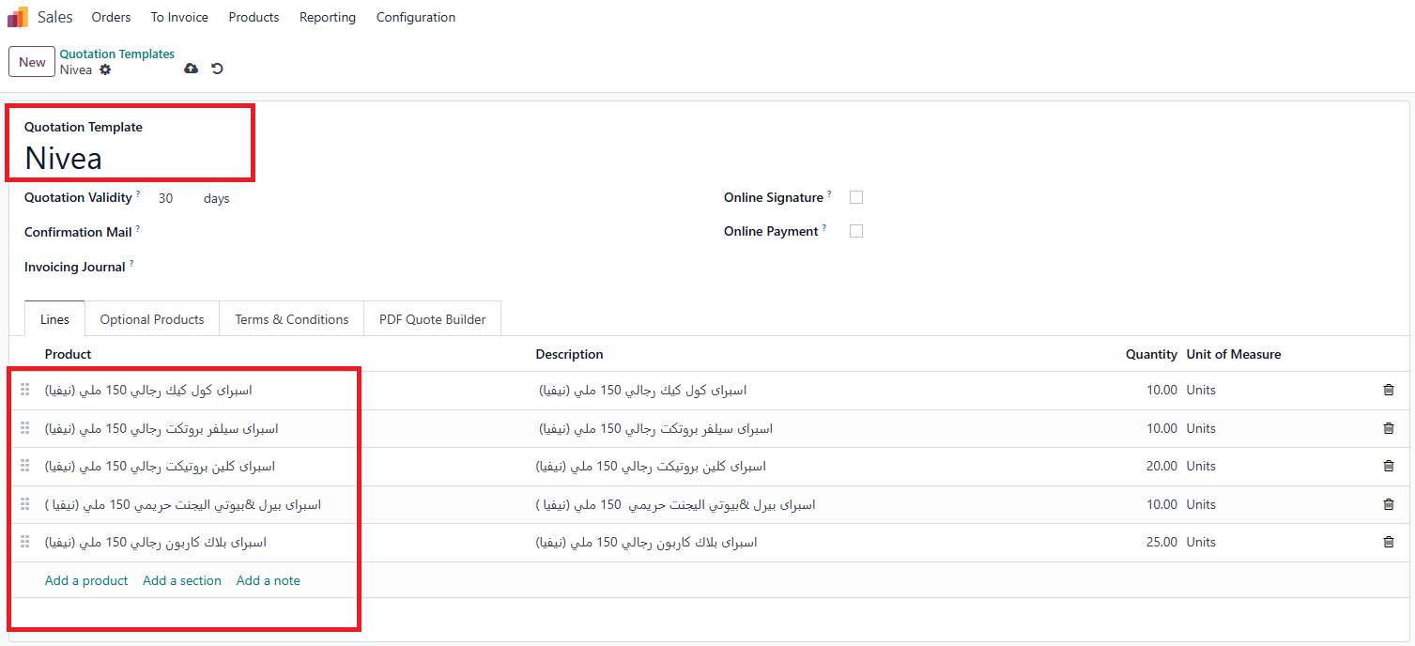
Quotation Template

Slide 38
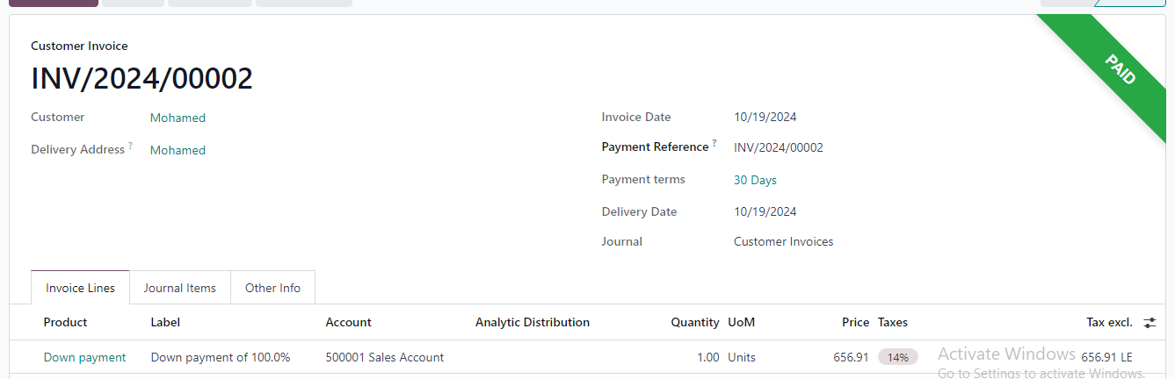
customer invoice

Slide 39
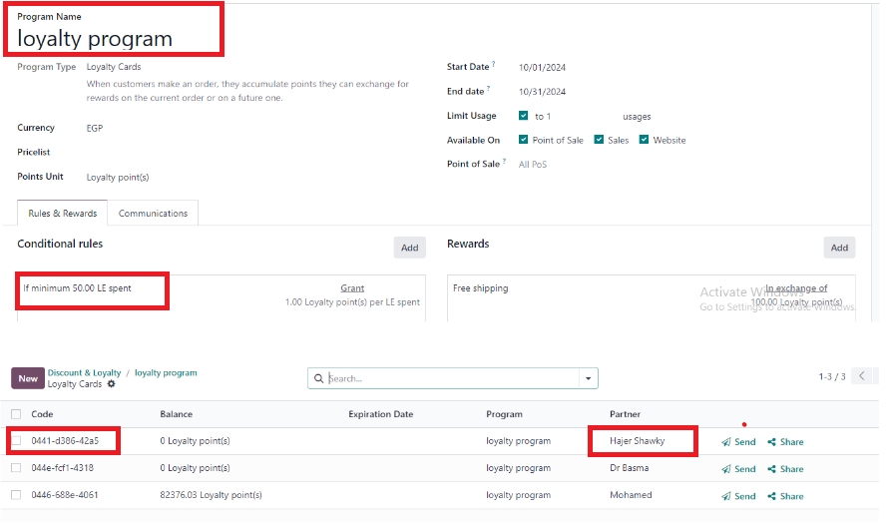
Discount & Loyalty(offers)

Slide 40
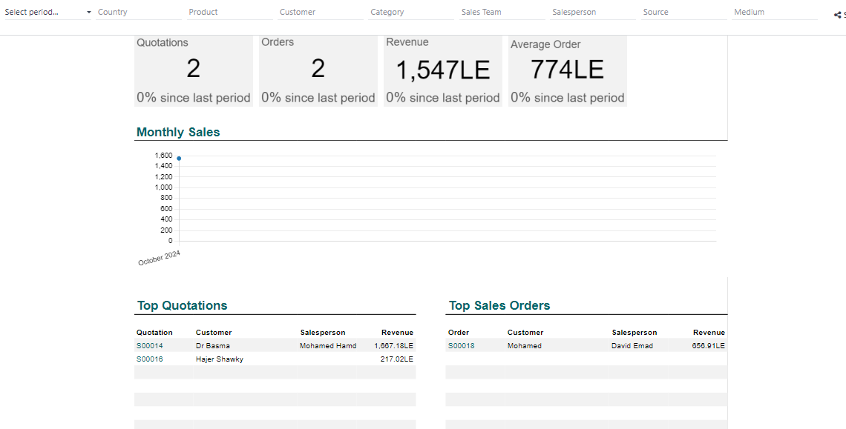
Sales Report

Slide 41
Point of Sale

Slide 42
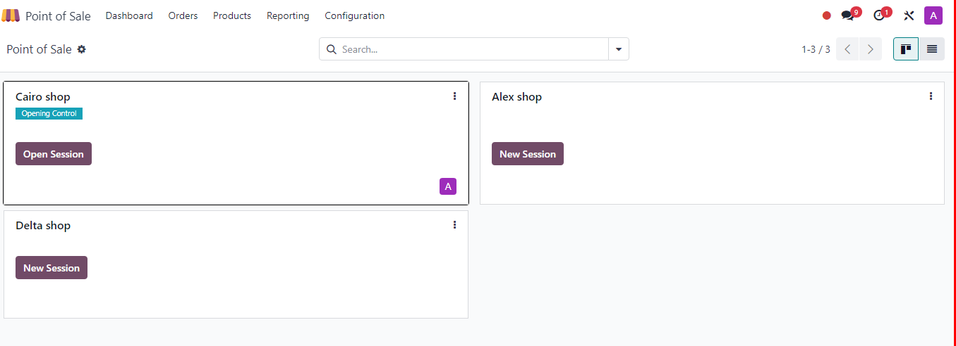
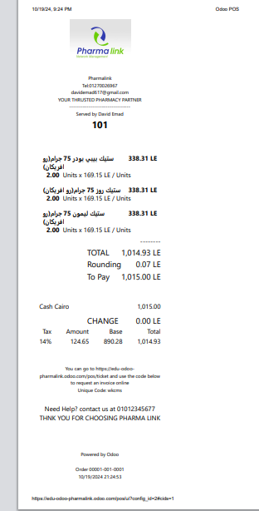
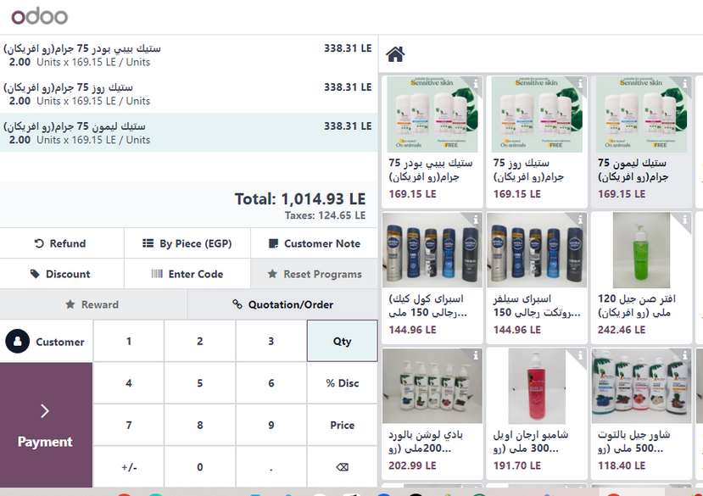
Point of Sale

Slide 43
HR
Employees
organization chart
contracts

Slide 44
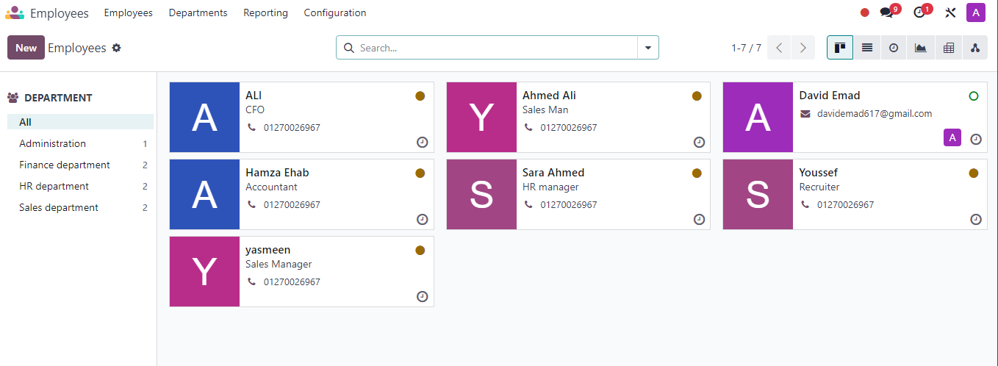
Employees

Slide 45
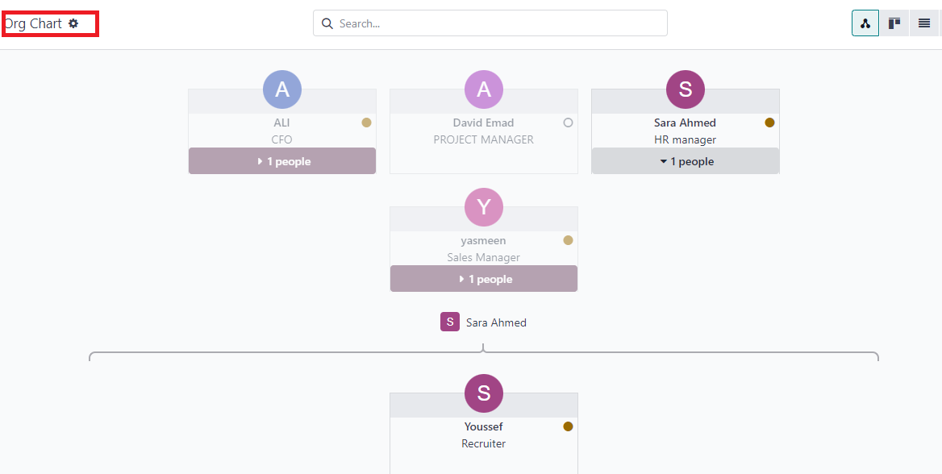
Organiztion Chart

Slide 46
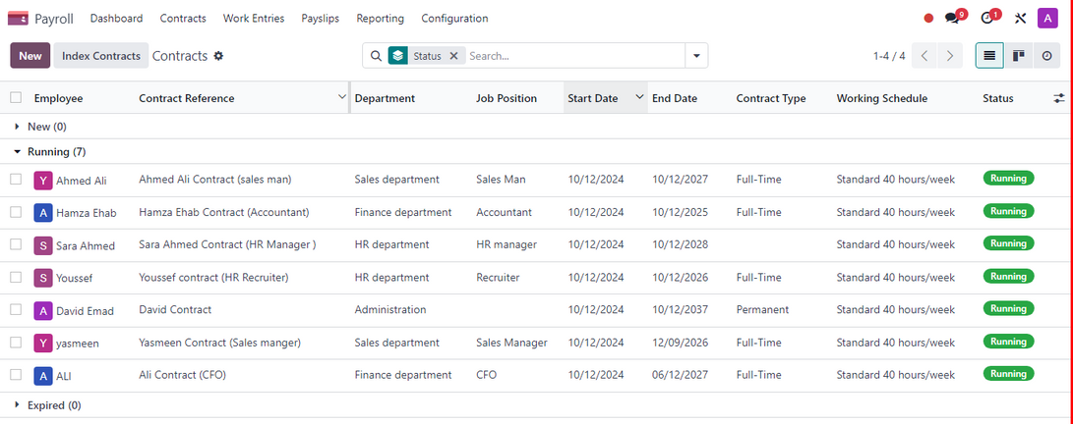
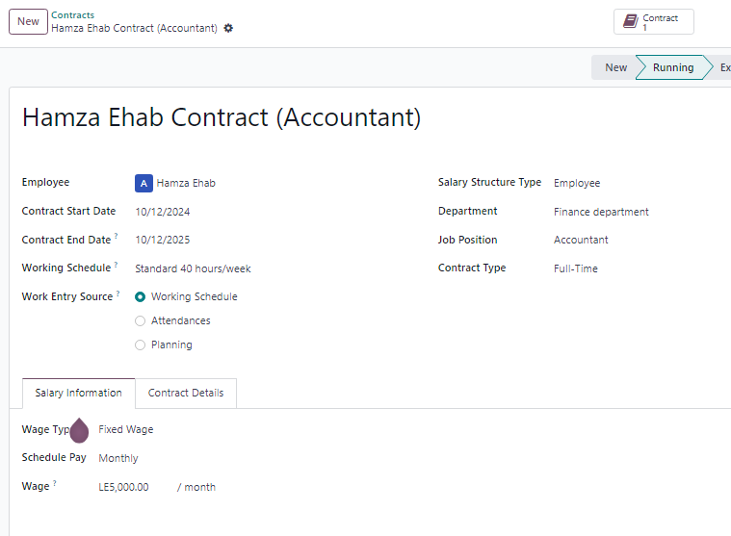
Contracts
Contracts Example

Slide 47
Accounting Module
chart of account
taxes
payment methods
Analytic Accouting
assets managment
Accounting Dashboard
Automated Journal Entries
Financial Statement

Slide 48
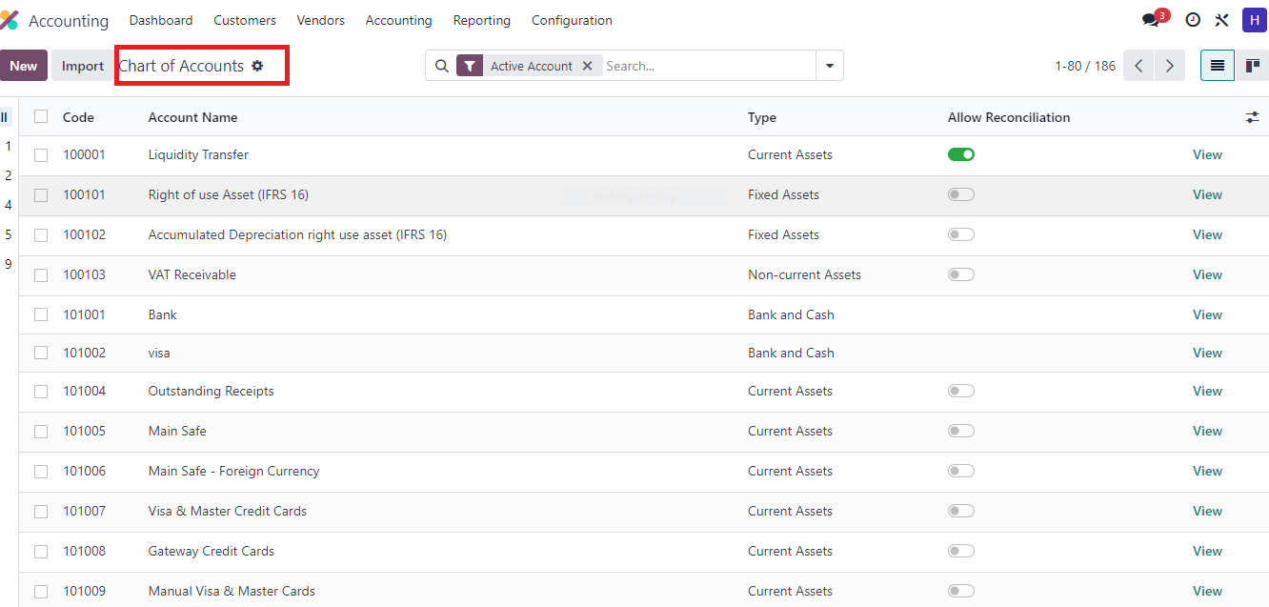
chart of account

Slide 49
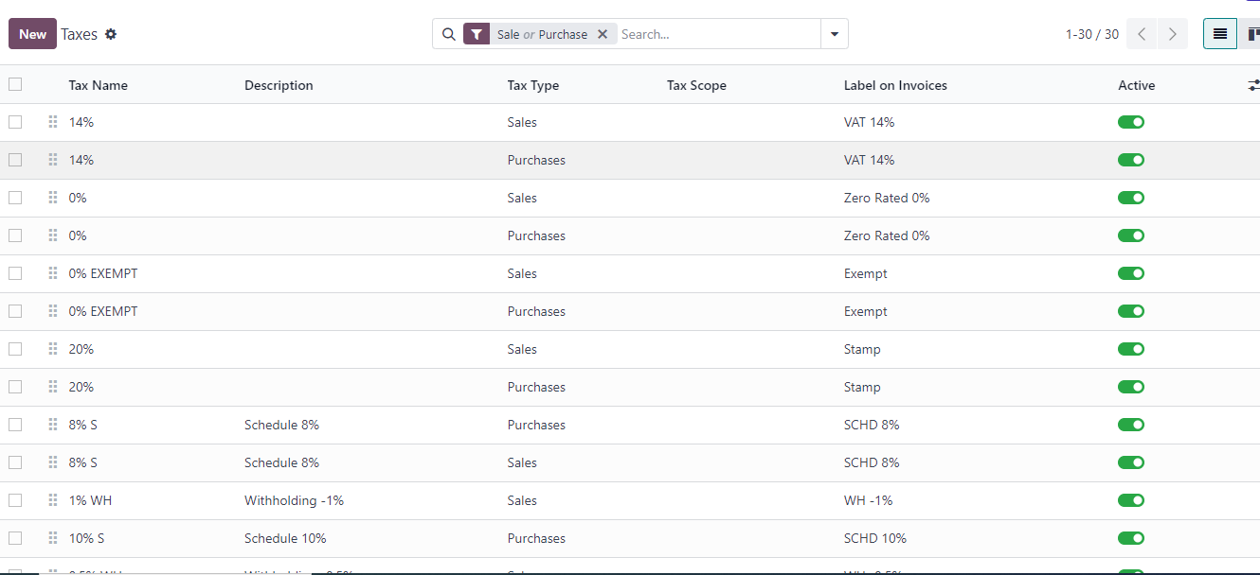
Taxes

Slide 50
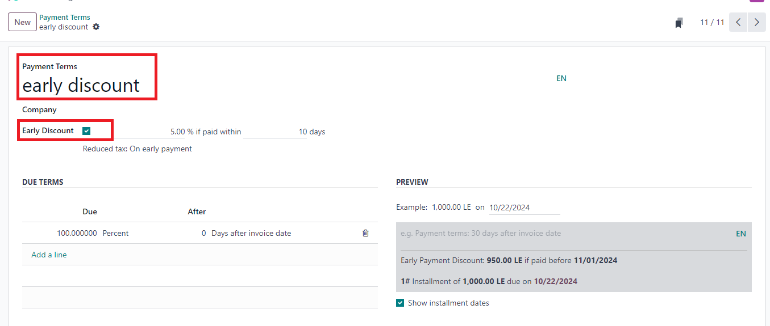
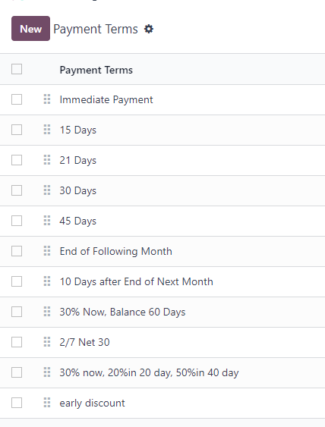
Payment Methods

Slide 51
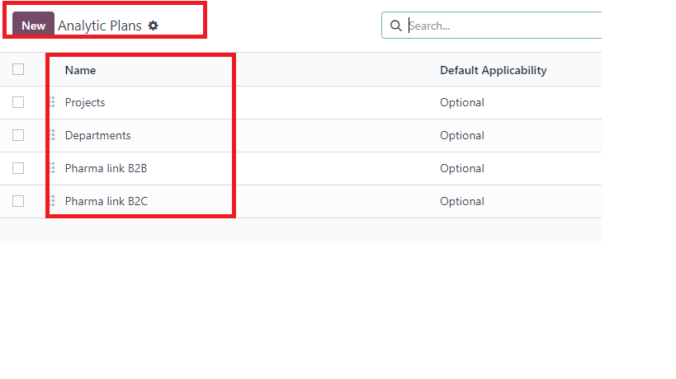
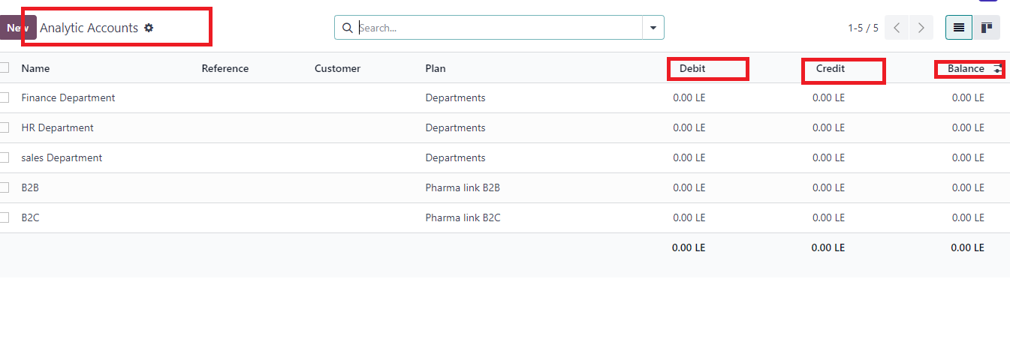
Analytic Accounting
Analytic Plan
B2B , B2C Departments
Analytic Account

Slide 52
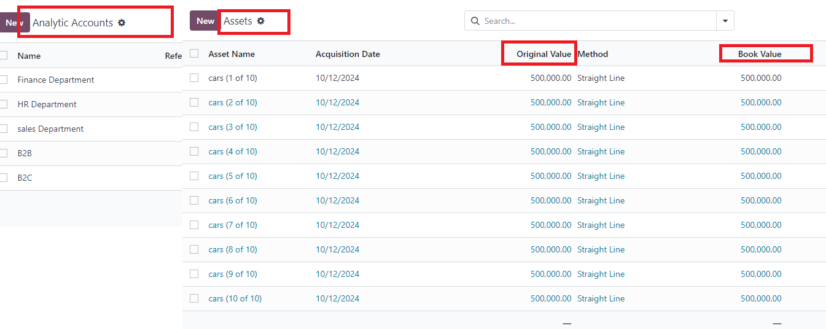

Assets Mangement
Depreciation

Slide 53


Accounting Dashboard
RECONCILIATION MODELS

Slide 54

Automated Journal Entries

Slide 55


Financial Statement :
Balance Sheet
Income Statement

Slide 56

Website

Slide 57

E-Commerce

Slide 58
Thank You

